Slide 1
Assurance Services for the Retail Electricity Market
Industry Governance Group (IGG)
Version 1
19th November 2025

Slide 2
Continual Assessment
What
How
Timeline
A self-declaration completed and returned by the Supplier on an annual basis.
A standardised template will be issued to all Large and Small Suppliers for completion and return.
Completed once a year
Impact
Expecting to be minimal, forms mainly to be pre-populated where possible.
2025 Timeline:
Template issued: 01/12/25
Supplier update & return: 16/01/26
Assurance review: 19 – 30/01/26
Thereafter annually
  Annual Assurance Declaration
  Section 4.3.1. - New Entrants and Market Participant Assurance Strategy and Approach outlined the completion of this form.
  The Annual assurance declaration and return is part of ‘Phase 2 – Continual Assessment’ assurance.
  Declaration period Jan – Dec 2025 (calendar year).
  The 2025 template has been issued to IGG reps for information in conjunction with this presentation.
  The following slides provide guidance for Supplier completion.
  A drop-in clinic is being arranged for week commencing 8th December to address Supplier queries.

Slide 3
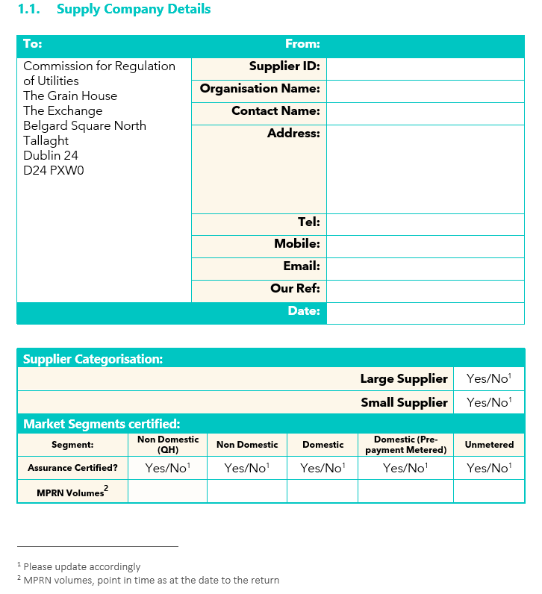
Continual Assessment
  Template fields that will be prepopulated for each Supplier:
    Supplier ID
    Organisation Name
    Date: (this will be as at the calendar year end 31st December 2025)
    Supplier Categorisation
  Supplier to update: Address and contact details
  Market Segments certified:
    Assurance Certified: Cells should be deleted accordingly with either a Yes or No response.
    MPRN Volumes: It is noted that there can be timing variances as can be constantly changing with CoS processes.
    Key Assurance assessment is whether Suppliers have potentially drifted into segments not certified.

Slide 4
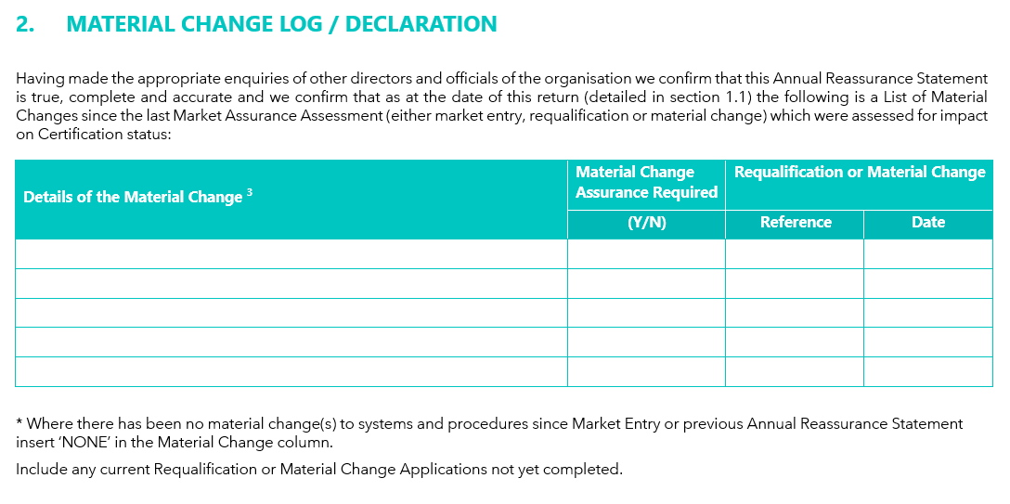
Continual Assessment
    Please include any Material changes that have:
      Completed during the period
      Have commenced and remain open at the period end (date should be left blank)
      Changes assessed as requiring no Assurance (either internally or conjunction with RMDS/Assurance Body)
    NB, reference will be from Suppliers records

Slide 5
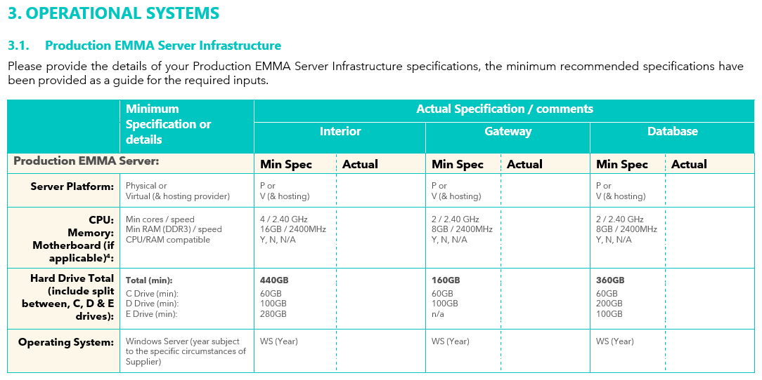
Continual Assessment
    Please provide your Production EMMA Server Infrastructure specifications. The Min Spec is for guidance.
    This is for the Large EMMA spec, where a Small EMMA is in place the template will reflect the Small EMMA specification.

Slide 6
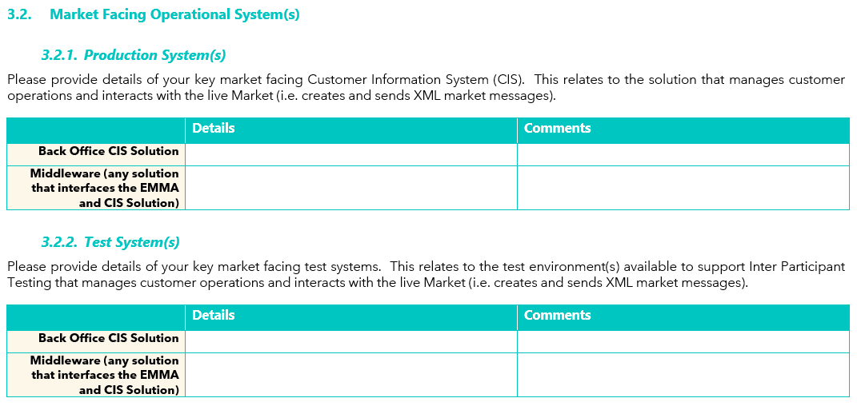
Continual Assessment
    Details of market interfacing systems at a high level.
    Where there are multiple test systems, please detail the overall number and use for each instance.

Slide 7
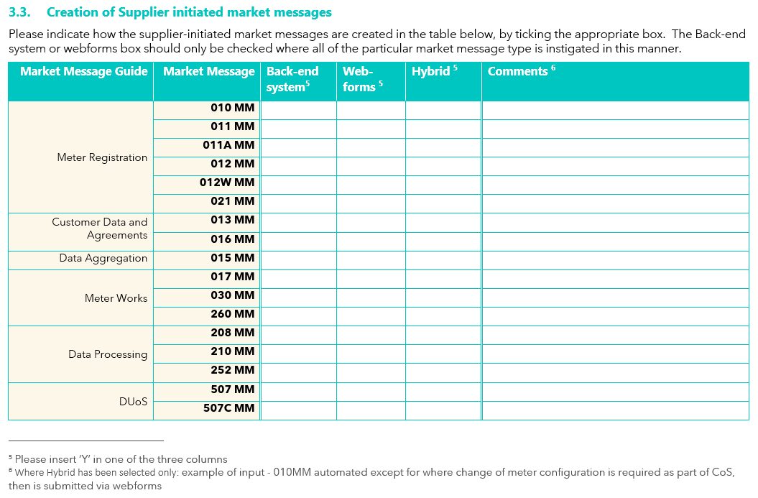
Continual Assessment
    Insert ‘Y’ in one of the three options for each market message
    For Hybrid only:
      Please include narrative in the comments box to advise selection criteria, an example has been provided in footnote ⁶

Slide 8
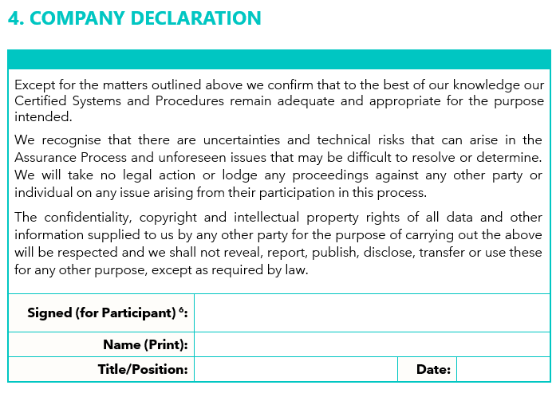
Continual Assessment
    The declaration requires completion by a Main Board Director or equivalent (in an organisation that is without a main board).

Slide 9
Thank you
For more information,
Please visit version1.com

