Slide 1
Industry Governance Group (IGG) Presentation ESB Networks Retail Market Services
21st June 2023

Slide 2
Agenda
Electricity Costs Emergency Benefit Scheme II
MCC12 Non Zero Estimates during power outage
Retail Market Services Survey Action Plan
Market Activity & TIBCO Outages
Tibco Housekeeping
V13.6 Microgeneration Transition

Slide 3
Electricity Costs Emergency Benefit Scheme II
Unallocated credit is to be returned by suppliers between 3 – 14 July 2023
Funds are only to be returned to the dedicated ESBN Electricity Costs bank a/c
Supplier ID must be included as a payment reference when returning funds
An email must be sent to electricitycostsbill@esb.ie The email subject line should include ‘Unallocated Credit for <Supplier Name> <Supplier ID>
Where funds are being returned an Unallocated Credit Report must also be uploaded to the SFTS;
For each Effective Date suppliers are requested to specify the amount of money which was unallocated for the MPRN. If no funds are being returned for an Effective Date then ‘0.00’ should be entered.
Please ensure that the amount of funds returned reconciles with the amount of funds reported as being returned.
Reporting template will be recirculated by RMDS
Please see Working Practice 0033 for reporting requirements

Slide 4
Sample Unallocated Credit Report
MPRN | Effective Date 27102022 | Effective Date 20122022 | Effective Date 27022023
10000000001 | 183.49 | 183.49 | 183.49
10000000002 | 183.49 | 183.49 | 183.49
10000000003 | 0.00 | 183.49 | 183.49
10000000004 | 183.49 | 183.49 | 183.49
10000000005 | 183.49 | 183.49 | 183.49
10000000006 | 183.49 | 183.49 | 0.00
10000000007 | 0.00 | 183.49 | 183.49
10000000008 | 183.49 | 183.49 | 183.49
10000000009 | 183.49 | 0.00 | 0.00
10000000010 | 183.49 | 183.49 | 183.49
10000000011 | 183.49 | 183.49 | 0.00
10000000012 | 183.49 | 183.49 | 183.49

Slide 5
Non-Zero MCC12 Estimates during power outage scenarios
The second validation routine fix is planned for early Q3 2023
Engagement will take place with impacted Suppliers once the fix is resolved
Retail Market Services Survey Action Plan
ESB Networks have commenced the Supplier Stakeholder 1-2-1 sessions and will be meeting with Suppliers in the coming months
Reminder that the Roles and Responsibility workshop is scheduled for Monday 26th June at 15:00 as per note issued from RMDS.
We encourage all Suppliers to attend the workshops and share the updates within their teams

Slide 6
Market Activity

Slide 7
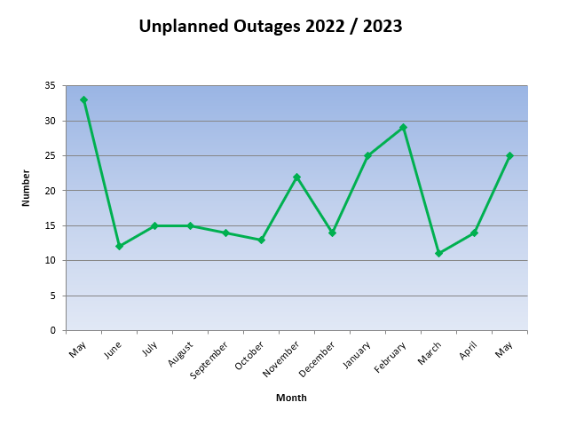
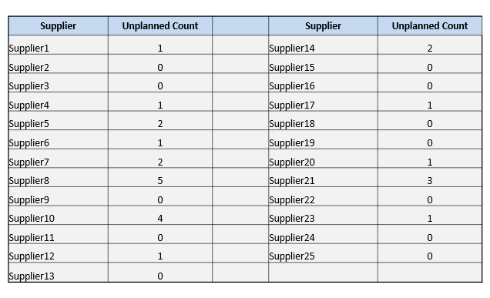
Tibco Outages (Unplanned)
May Unplanned Outages 2023
Suppliers are reminded to use the outage notification facility to notify ESB Networks of planned outages

Slide 8
Tibco Outages (Planned)

Slide 9
TIBCO Housekeeping
Suppliers are reminded of the regular housekeeping requirements e.g. database re-orgs which keep EMMAs running more efficiently.
Digital Certificates:
Suppliers are reminded to check their Production EMMA and Test EMMA Certificates to ensure they are kept up to date otherwise the EMMA will not work if the digital cert expires.
A notification issues to advise when a digital certificate is due to expire, usually approx. 60 days before expiry. Additional notifications issue as the expiry date moves closer.
Suppliers should ensure that they take action on receipt of the notifications as it can take time to get the cert procured and installed.
Suppliers are reminded to ensure that updated contact information for the notification emails are sent to Market Message Hub Support team (RetailMarketHubSupport@esb.ie) to ensure that the notification emails are going to the correct people
Infrastructure Changes
Suppliers are requested to let the Market Message Hub Support team (RetailMarketHubSupport@esb.ie) know of any changes that may impact the TIBCO EMMA e.g. IP Address change

Slide 10
V13.6 Microgeneration Transition
Suppliers asked at IGG in May, to confirm if they agreed with the proposal for Suppliers to write to their impacted MCC02 NTNP customers
Thanks noted for responses received which were all in agreement of this action
ESB Networks will review the Microgeneration area of the website and any subsequent updates will be made by the 31st July.
Please refer to the Microgen transition email issued from RMDS on 26th May with associated timelines and details.

Slide 11
Thank You

