Slide 1
MRSO Update
James Long
21st June 2023
Gerry Halligan

Slide 2
Debt Flagging
 | Feb - 23 | Mar – 23 | Apr - 23
Total Debt Notifications received (012) | 224 (15 | 1520 (15) | 333 (20)
Total Debt Notifications not forwarded for reason implied or explicit CoLE, timeout, etc. | 24 (0) | 120 (3) | 48 (5)
Total Debt Notifications sent to gaining supplier (112) | 200 (15) | 1400 (12) | 285 (15)
Total not cancelled | 155 (13) | 1324 (11) | 104 (13)
Total cancelled | 45 (2) | 76 (1) | 181 (2)
Total Debt Notifications sent to gaining supplier as % of total COS | 0.75% | 4.6% | 0.98%
May – 23
281 (27)
35 (4)
246 (23)
157 (18)
89 (5)
0.74%
Figures in brackets represent situations where an ESB Networks PAYG meter is installed.

Slide 3
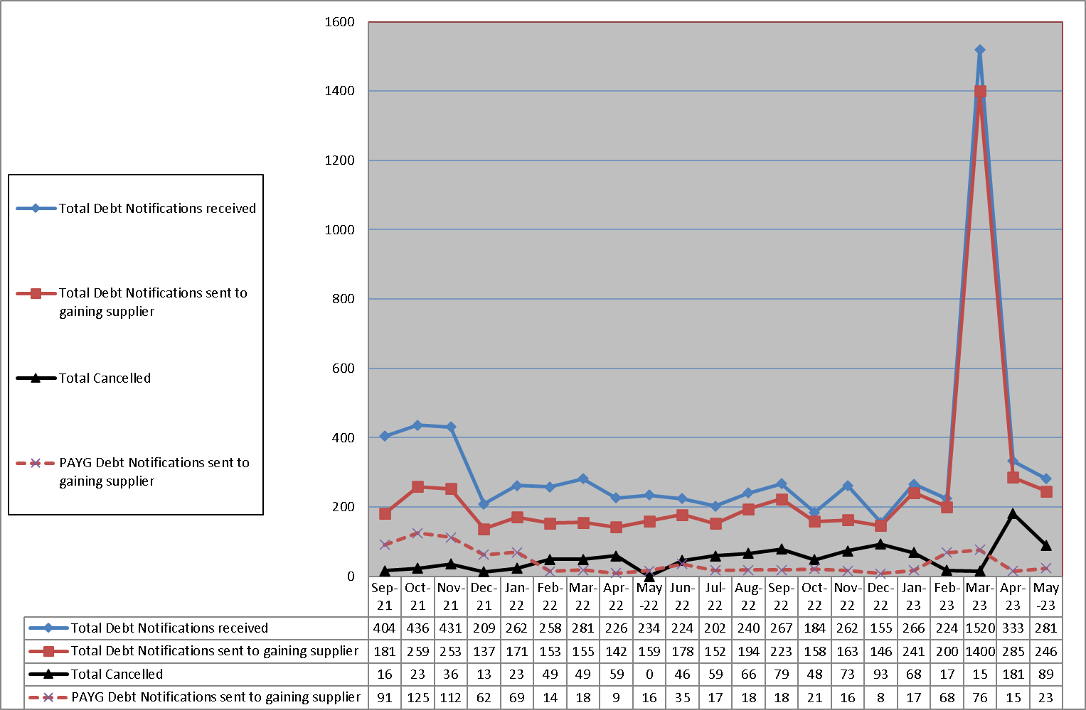
Debt Flagging

Slide 4
Objections – Erroneous Transfer
 | Feb - 23 | Mar – 23
No. of Objections | 65 | 65
Cancellations from Objections | 13 | 12
Objection emails to MRSO | 10 | 4
Reasons:
Uncontactable by phone | 2 | 1
Written communication | 2 | 1
COS confirmed | 6 | 2
Other
Escalation emails | 3 | 16
Apr-23
51
9
1
1
1
May– 23
46
7
11
3
2
6
9

Slide 5
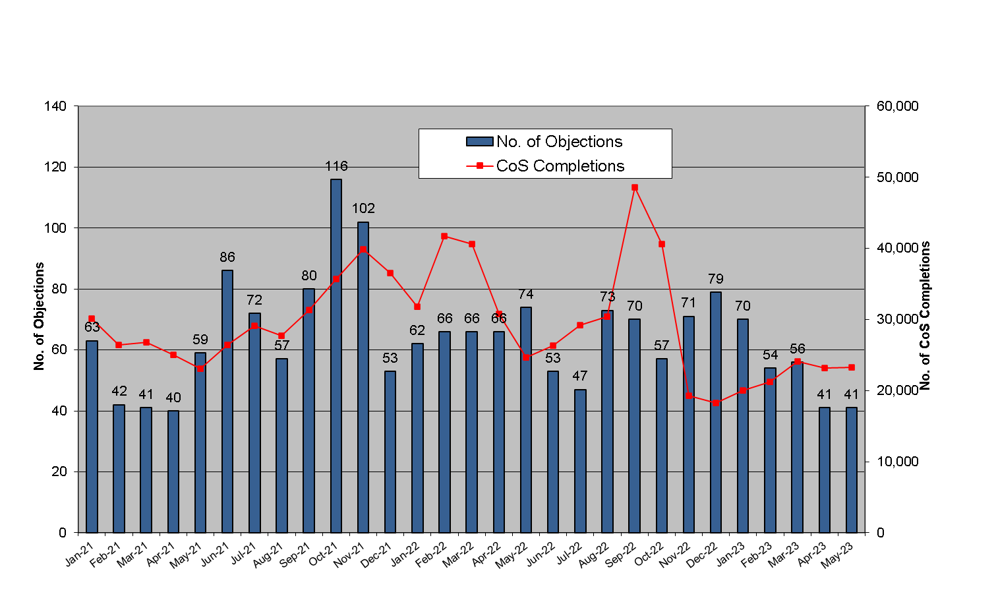
Objections – Erroneous Transfer

Slide 6
List of new Smart MCC Switches as of 19th June 2023
MCC 12 – New Smart HH
Total to date – 168,402
MCC 16 – New Smart Day / Night / Peak
Total to date – 27,659

