Slide 1
MRSO Update
James Long
22nd October 2025
Gerry Halligan

Slide 2
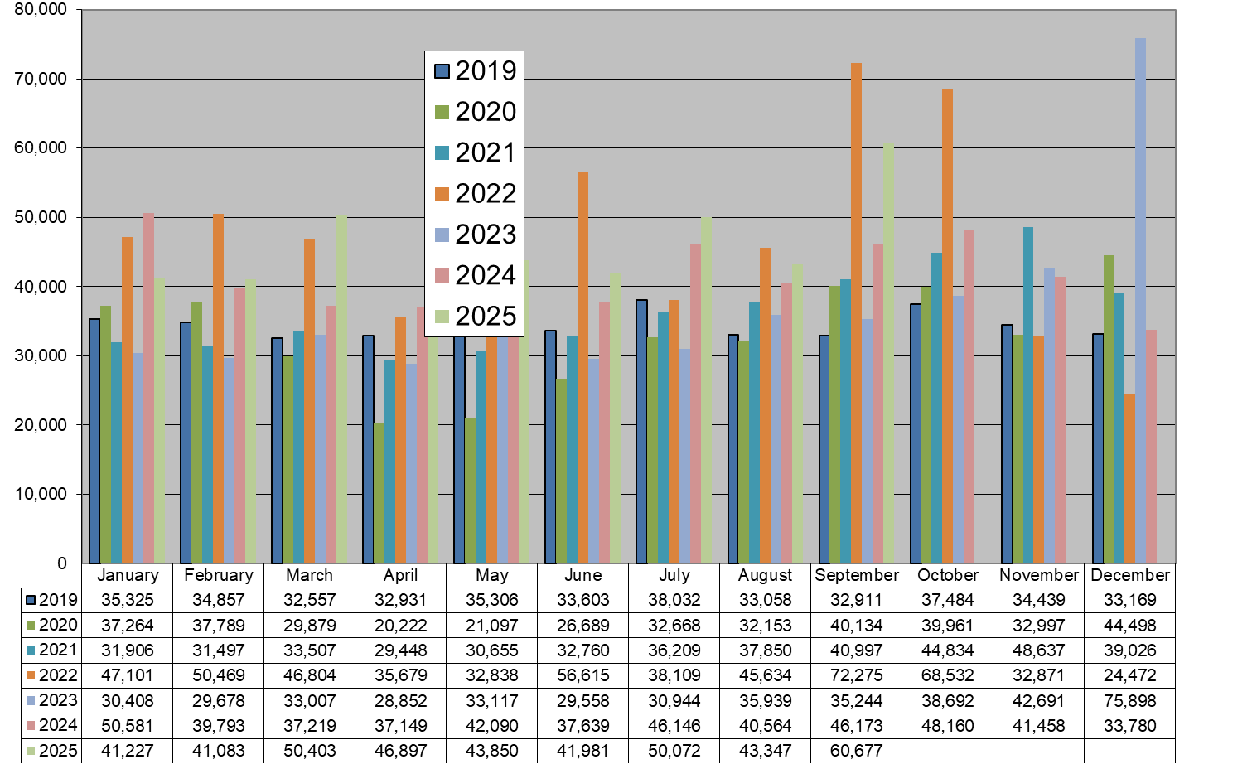
Market Message 010

Slide 3
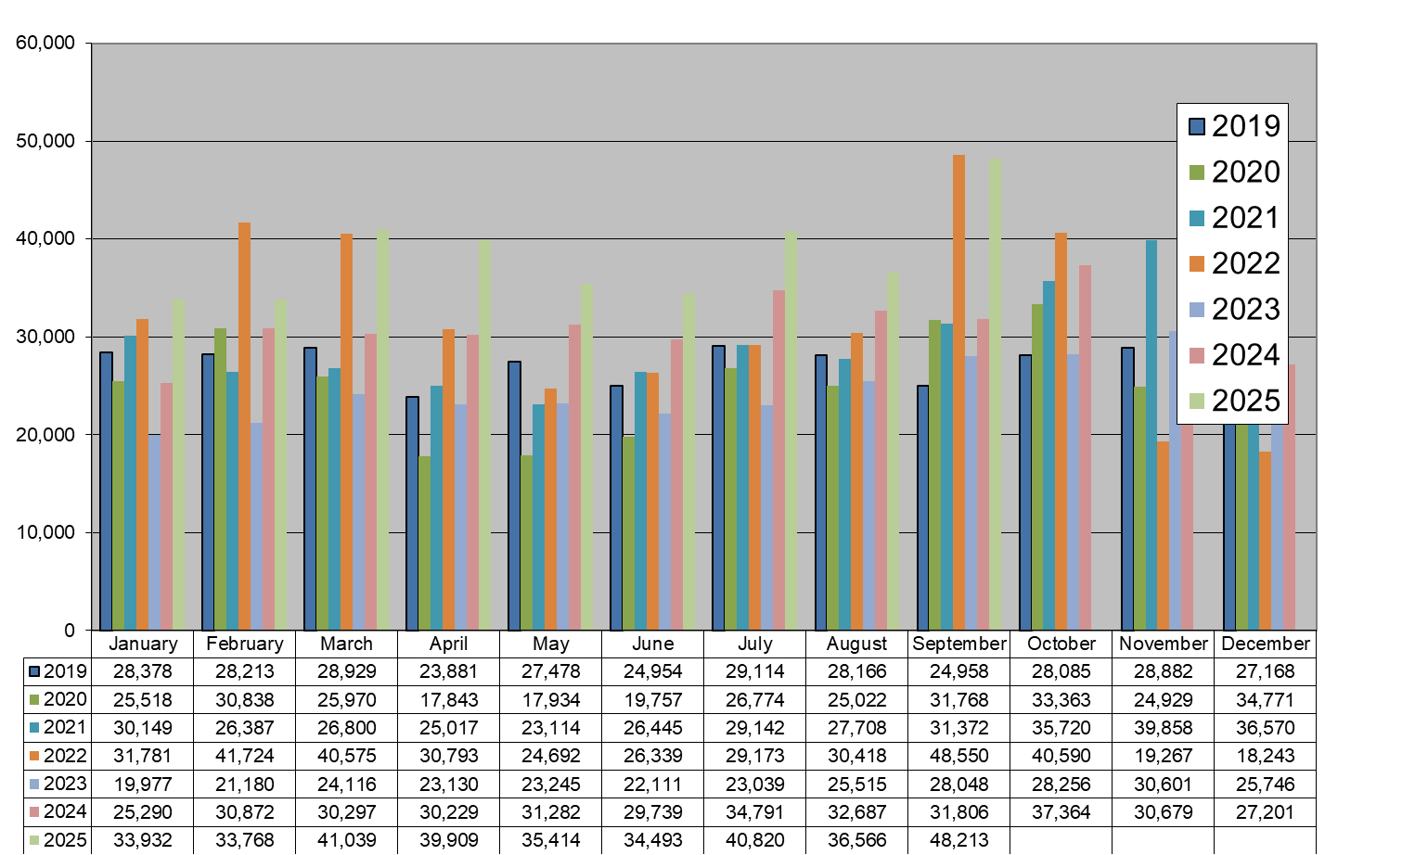
Market Message 105L

Slide 4
COS in-progress 20th October 2025 – 4,752
  Review older (>3 months) switches monthly
  Suppliers notified of individual switches outstanding and reason
  Switch outstanding for energisation or Token Meter removal will not time-out
  MRSO contact scheduling centre to re- schedule or contact supplier to submit cancellation
  10 switches held due to an existing Open Service Order
Mar 2021 | 2
Apr 2022 | 1
Aug 2022 | 1
Nov 2022 | 3
Dec 2022 | 3
Mar 2023 | 3
Apr 2023 | 1
May 2023 | 3
Jun 2023 | 1
Jul 2023 | 1
Sept 2023 | 2

Slide 5
COS and CoLE
Month | Explicit CoLE | Inferred CoLE | Total CoLE | Total 010 | % Explicit CoLE | % Total CoLE
June-25 | 12,907 | 8,790 | 21,697 | 41,981 | 31% | 52%
July-25 | 15,350 | 9,940 | 25,290 | 50,072 | 31% | 51%
Aug-25 | 12,411 | 9,098 | 21,509 | 43,347 | 29% | 50%
Sep-25 | 22,012 | 10,608 | 32,620 | 60,677 | 36% | 54%

Slide 6
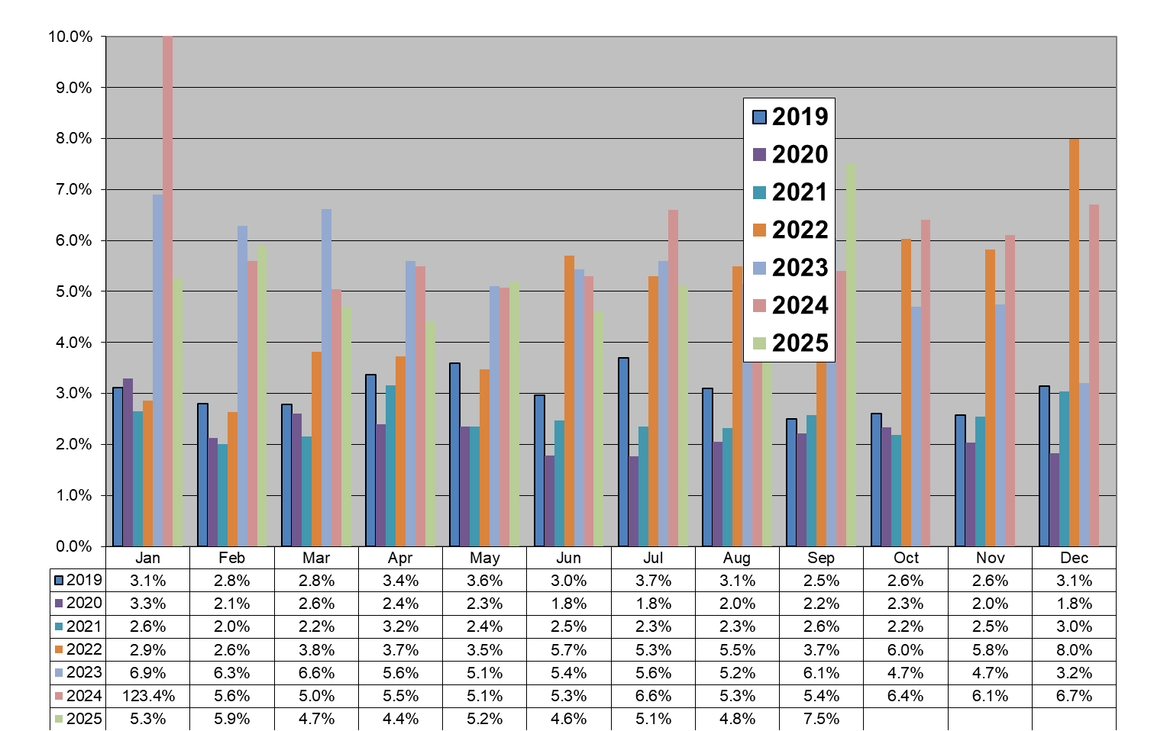
Registration Rejections %

Slide 7
Debt Flagging
 | July - 25 | Aug - 25 | Sept - 25
Total Debt Notifications received (012) | 279 (19) | 219 (15) | 242 (17)
Total Debt Notifications not forwarded for reason implied or explicit CoLE, timeout, etc. | 40 (3) | 37 (0) | 49 (1)
Total Debt Notifications sent to gaining supplier (112) | 239 (16) | 182 (15) | 193 (16)
Total not cancelled | 175 (14) | 147 (15) | 132 (14)
Total cancelled | 64 (2) | 35 (0) | 61 (2)
Total Debt Notifications sent to gaining supplier as % of total COS | 0.48% | 0.51% | 0.40%
Figures in brackets represent situations where an ESB Networks PAYG meter is installed.

Slide 8
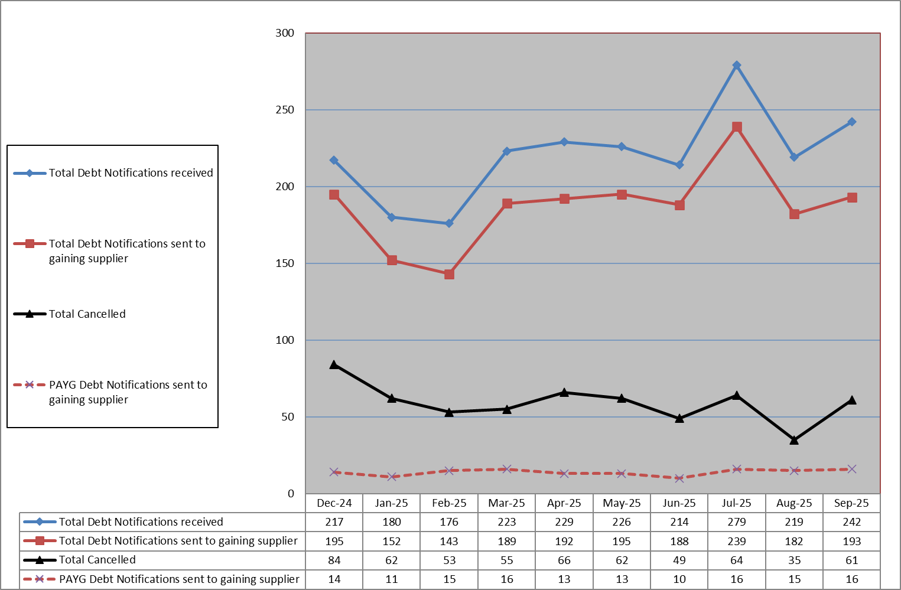
Debt Flagging

Slide 9
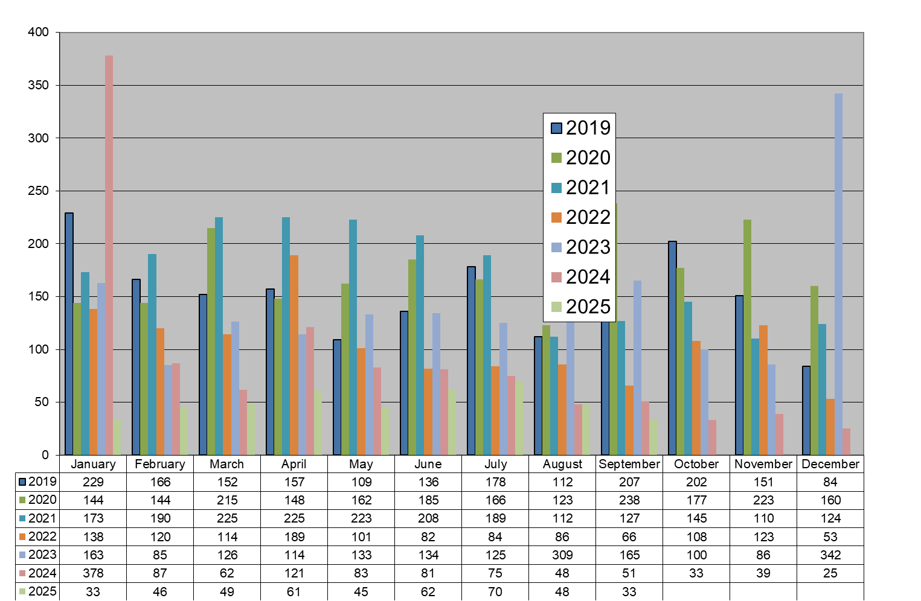
Disputed Reads

Slide 10
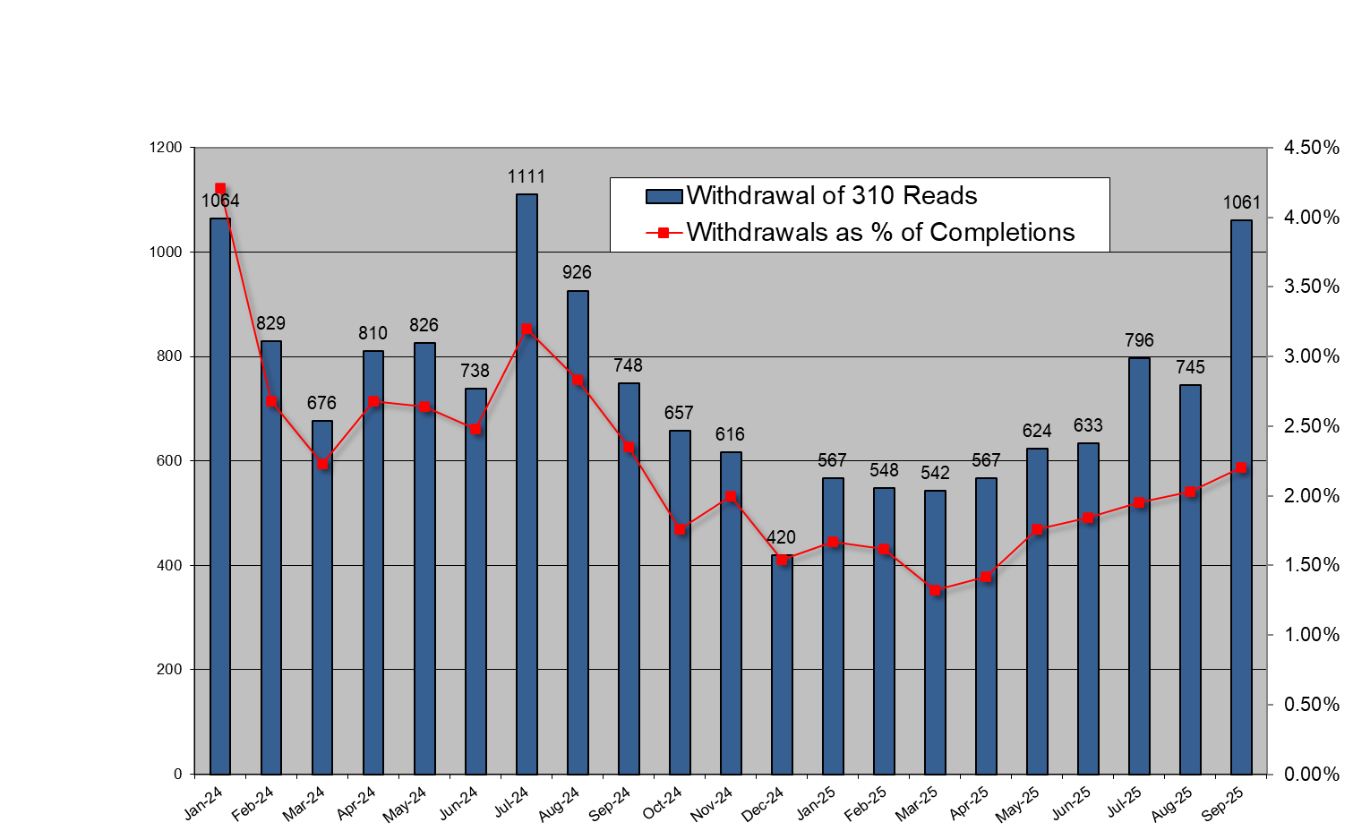
Total Withdrawal of 310 reads for all Suppliers

Slide 11
Objections – Erroneous Transfer
 | July - 25 | Aug - 25
No. of Objections | 68 | 58
Cancellations from Objections | 7 | 5
Objection emails to MRSO | 5 | 11
Reasons:
Uncontactable by phone
Written communication | 2 | 3
COS confirmed | 3 | 8
Other
Escalation emails | 6 | 2
Sept - 25
54
4
5
4
1
7

Slide 12
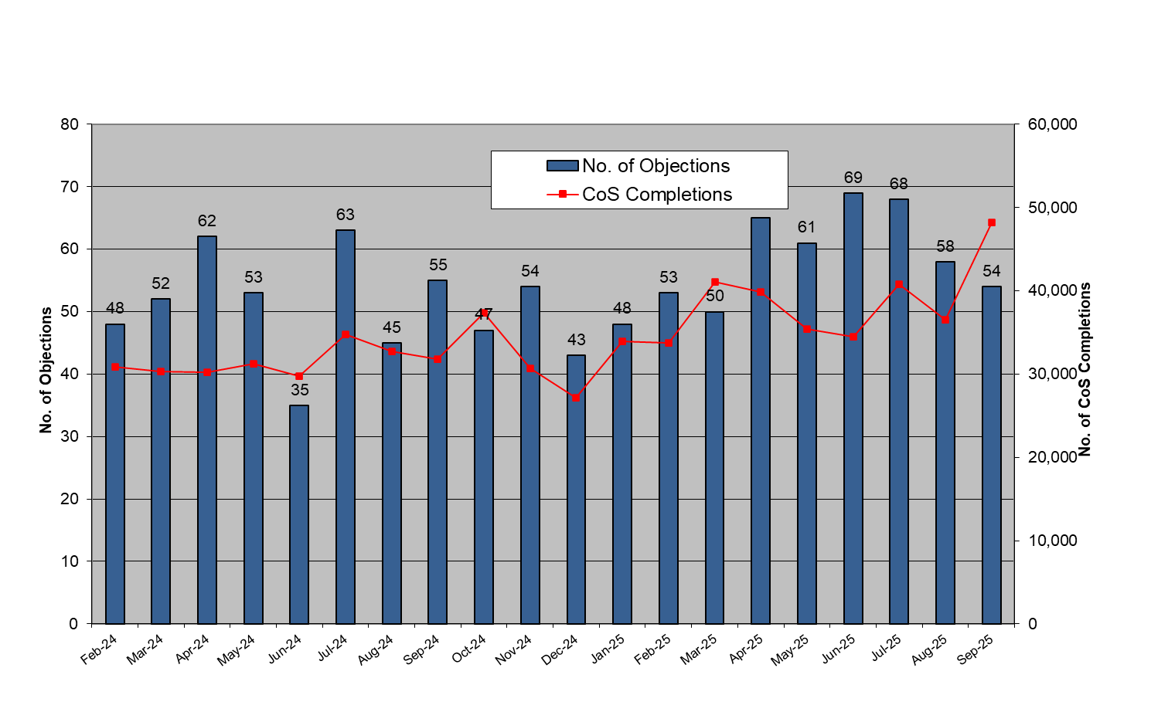
Objections – Erroneous Transfer

Slide 13
List of new Smart MCC Switches as of 20th October 2025
MCC 12 – New Smart HH
Total to date – 539,286
MCC 16 – New Smart Day / Night / Peak
Total to date – 74,814

